Slide 1
Microelectronic Control Systems
Temperature Controller

Slide 2
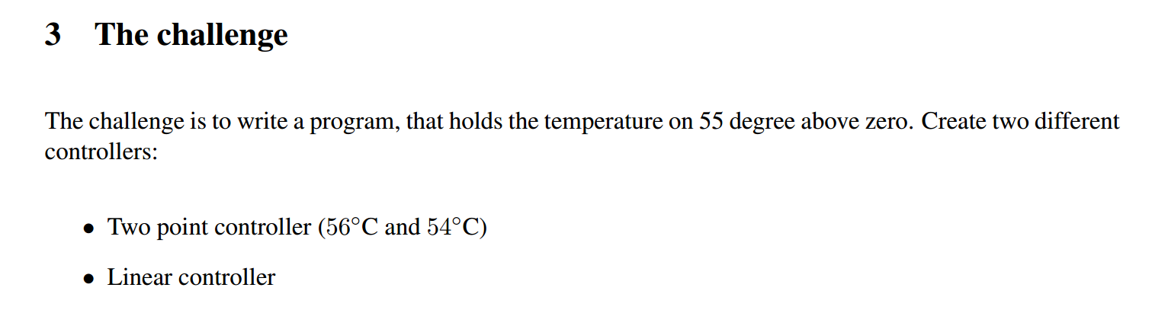
Temperature control: the task

Slide 3
Temperature control: Two point controller
Two point controller:
you should create a controller that does following: if temperature reaches 56C, it switches the fan on. If temperature falls below 54C, the fan is switched off. 56C and 54C are two measurements points giving the controller its name.

Slide 4
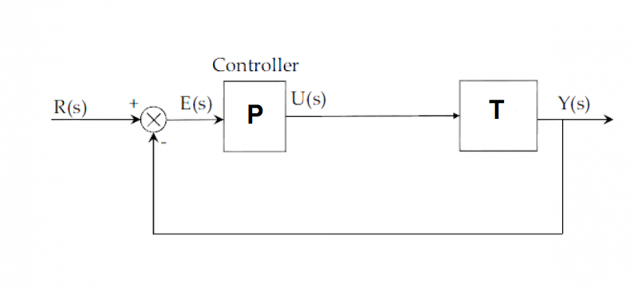
Temperature control: Linear controller
Linear controller:
A linear controller should be known to you from Measurement and Control course. It is the P controller, meaning the control signal is the error times a constant.
Consider: the goal is to keep temperature at 55C. However, if you choose it as a setpoint, error at 55C will be zero, with zero power output to the fan (heater on). Therefore you will not be able to stabilize your temperature at 55C with setpoint of 55C.

Slide 5
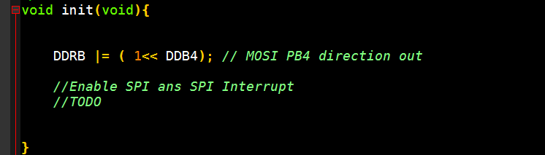
Getting the Temperature reading
To set up both controllers we will need to know the Temperature reading from the sensor. Since the sensor is a part of another system (not the AVR board you are programming), we have to receive the reading over Serial Peripheral Interface(SPI).
Indeed, the first TODO in the init.c is about SPI:

Slide 6
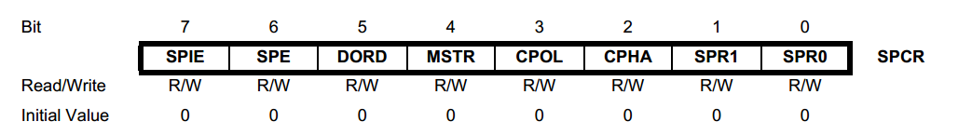
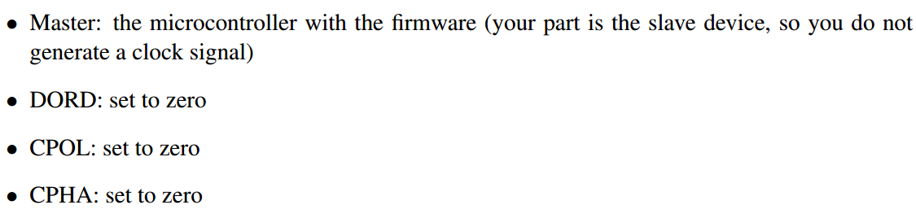
SPI programming
In the SPI section of the datasheet we find the register responsible for SPI setup: SPI Control Register (SPCR)
You need to decide on values of individual bits. Use datasheet for explanations (around p.125) together with the hints from the lab:

Slide 7
SPI programming: bits
To help you with individual bits: you need to enable SPI, one of the bits does it, and you need to enable SPI Interrupts.
SPIE stand for SPI Interrupts Enable bit;
SPE stand for SPI Enable.

Slide 8
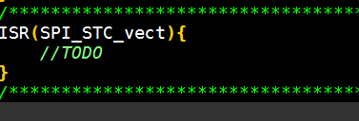
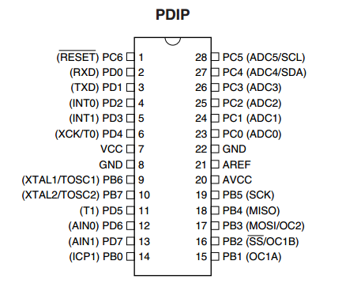
SPI programming part 2
It is advisable to use interrupt, which is easier way to read SPI:
Additional hint: you can see that PB4
has alternative function as MISO,
meaning Master Input, Slave Output.
Put it to output, as your device works
as a slave in the setup.

Slide 9
SPI programming part 3: input / output
If you did the initialization right, then the temperature reading will appear in the SPDR (SPI Data Register). Whenever you will write a new value to SPDR, it will be transmitted to the master device as a command for the fan.
Temperature = SPDR; // READ TEMPERATURE
SPDR = fan_power; // SEND FAN OUTPUT
Remember: you must select SPI mode in the GUI program on the Ubuntu workstation. To start the GUI program, call TempController from the terminal.

Slide 10
Completing the 2 Point control
So, now that you can read temperature data, use if statements to choose when to run fan at full power, and when to switch it off.
Use TempController software on the workstation to plot the resulting temperature behavior. Save a plot. → Continue to linear controller.
Remember: the output can only be a positive 8 bit number. You risk unpredicted behavior if you do not check/limit your output.

Slide 11
Microelectronic Control Systems
Rotor Stroboscope

Slide 12
Task description: Rotor stroboscope
Write a program to get the reading of the potentiometer
2. Use this value to create a PWM signal to set the rotation speed
3. Write a function to measure the rotation speed with the light barrier
4. Let the LEDs ﬂash a short time when the rotor is vertical
5. Then let the LEDs ﬂash a short time when the rotor is horizontal

Slide 13
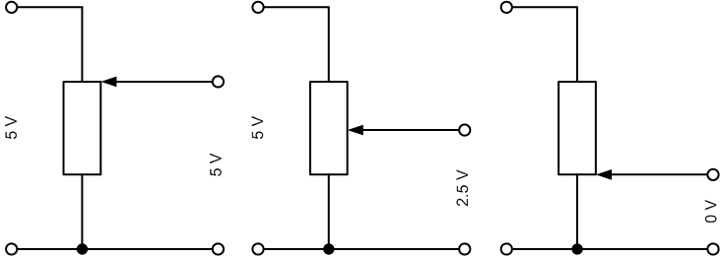
Rotor Stroboscope: Potentiometer
1. Write a program to get the reading of the potentiometer
Remember, a potentiometer is a device which acts as a manually adjustable voltage divider, which has an output as a voltage between 0 and 5 volt in our case.
This is an analog voltage, which means you have no choice but to use ADC to read it.
Lets check the code in the template.

Slide 14
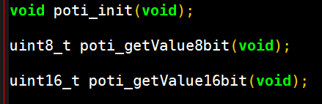
1. Reading potentiometer: template functions
In the header file poti.h we learn what functions handle the potentiometer for us:
So there are functions to initialize the relevant hardware poti_init();
And two functions to read the value, in form of a 8 or a 16 bit value:
poti_getValueXbit();

Slide 15
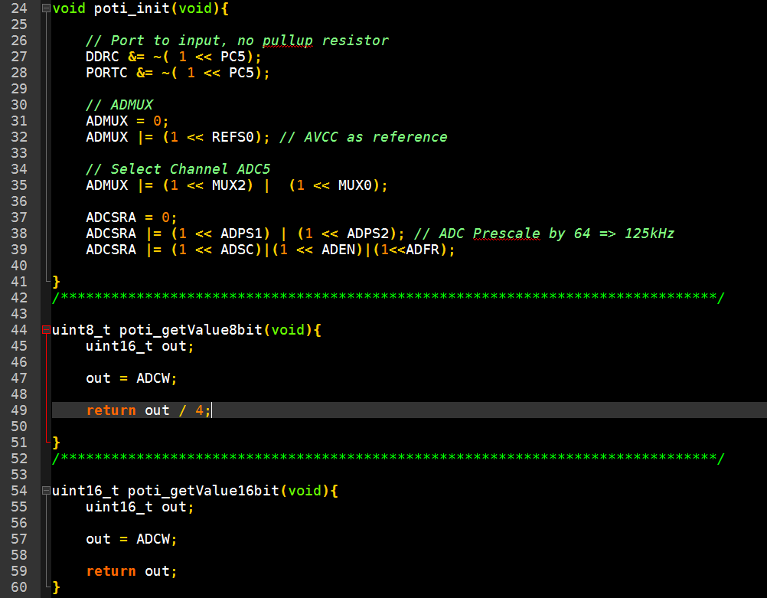
1. Reading potentiometer: code
Looking at poti.c we will see that the file contains no //TODO parts, it is ready to use!

Slide 16
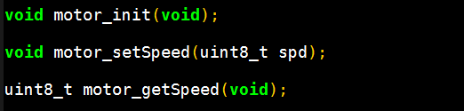
Rotor stroboscope – PWM
2. Use this value to create a PWM signal to set the rotation speed
We are going to use PWM to control the speed of the DC motor of the rotor. We could generate PWM in the software, but the template is almost ready to provide us with
Hardware PWM.
As before, let us take a look at the header file in the code: motor.h

Slide 17
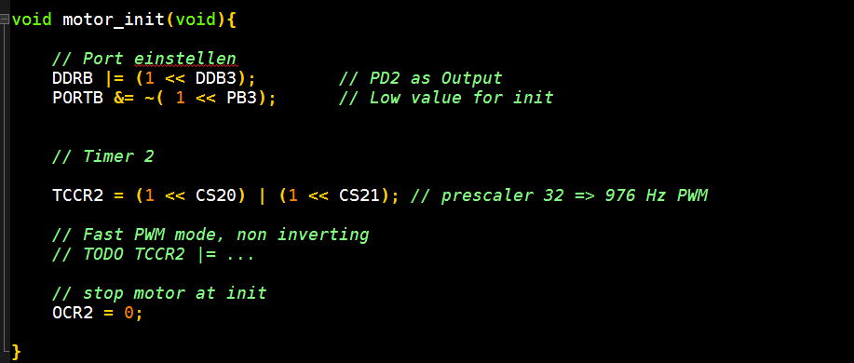
2. Rotor speed control via PWM: code
Next, we look into motor.c to see what code we need to complete:

Slide 18
2. Rotor speed control via PWM: hardware PWM
To solve this //TODO, find description of the TCCR2 register bits, and their functions in the atmega8.pdf datasheet.
Hint 1: you will need to set 3 bits in total in this //TODO
Hint 2: before you test this code, make sure all init() functions (motor init, poti init, other?) are included before the strart of our usual infinite loop. There is no //TODO, yet the template main.c is incomplete.

Slide 19
2. Rotor speed control via PWM: testing
Hint 3: if you did it right, test it using code
While(1)
{
motor_setSpeed(200);
_delay_ms(1500);
motor_setSpeed(0);
_delay_ms(1500);
}
Your rotor should start and stop with small intervals.
The _delay_ms functions create separated breaks of 1,5 s duration.
Logically, the speed of 0 means no rotation.

Slide 20
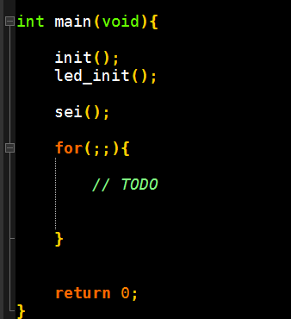
2. Rotor speed control via PWM – user input
When this works fine:
use poti_getValue function to set speed of the rotor. This will make speed depend on the angle or rotation on the potentiometer, therefore directly controlled by the user.

Slide 21
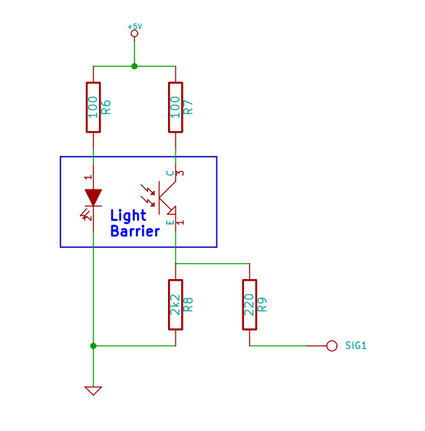
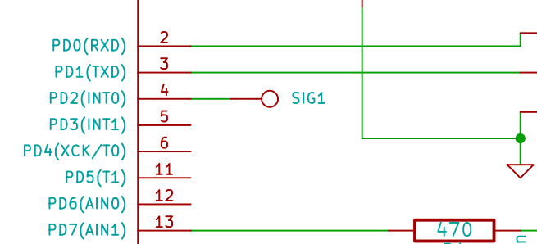
Rotor stroboscope: Task 4
4. Let the LEDs ﬂash a short time when the rotor is vertical
This is rather easy if you understood the electrical schematic from the lab instruction:

Slide 22
4. Vertical stroboscope
So when the rotor will be vertical, it will mechanically block the IR-light falling on the phototransistor.
Find out, what voltage level will come on the pin PD2, and use this condition to control LEDs:
If(…)
led_on();
else
led_off();

Slide 23
Rotor stroboscope: Task 3
3. Write a function to measure the rotation speed with the light barrier
For convenience, we will use the frequency with which light barrier is blocked.
Easy definition of frequency of some event is: (N events) / (Time period).
Another solution is to find the period T, and use formula f = 1/T.
If you have some idea how to accomplish this task, you are welcome to use your solution. An example solution will be discussed in next slides.

Slide 24
3. Rotor frequency
We will proceed with solution using period T.
It should be measured by Timer/Counter0 with prescaler of 1024 (reuse the code from microcontroller basics lab to set up T/C and prescaler)
To ensure exact measures, we will use hardware interrupt INT0 coming from light barrier to PD2 pin. (Here again, reuse the code from microcontroller basics lab to set up the interrupt).
As the measurements may vary, we will average 4 last measurements to get real time frequency. Therefore, you will need and array to remember 4 values: uint16_t T[4];

Slide 25
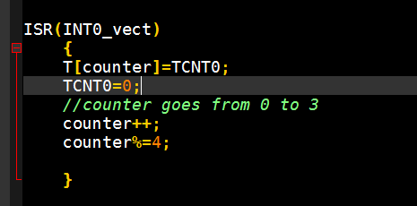
3. Rotor frequency: calculation
In the ISR(INT0_vect) you should have following code:
In the main loop, you can now get the period of the rotor as:
T=(T[0]+T[1]+T[2]+T[3])/4;
REMARK: T, counter and any variable you modify in the interrupt must be volatile
If you would want to calculate the period in seconds, remember: 1 count of T/C with prescaler of 1024 is (1024/8M) seconds long.

Slide 26
Rotor stroboscope: Task 5
5. Then let the LEDs ﬂash a short time when the rotor is horizontal
Now, we need to be able to switch the LEDs on shortly when the blade is horizontal. But: there is no sensor to tell us directly that the blade is horizontal now.
We will use period T calculated in task 3, and light LEDs half a period after the light barrier was triggered.
We will use:
Timer/Counter1 with prescaler of 64,
Compare interrupt(TIMER1_COMPA_vect, In the example we will use OCR1A register).
Please take care of initialisation of both interrupt and T/C with prescaler.

Slide 27
5. Horizontal strobe
To set up compare interrupts, check TIMSK, TCCR1A and TCCR1B, look for compare interrupts.
How the code will work:
First, every time you are in vertical position, timer is set to wait for half a period.
After this time the LEDs are switched on, timer is set for about 3% of the period.
After this small delay LEDs are switched off.

Slide 28
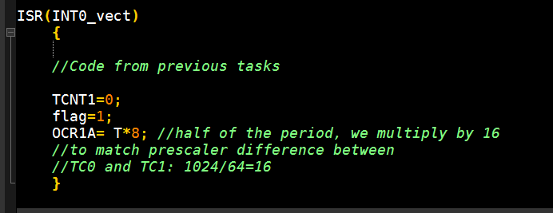
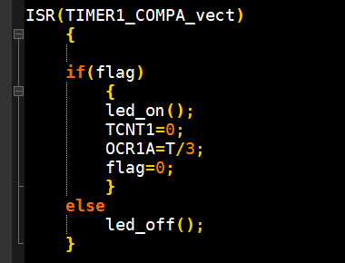
5. Horizontal strobe: code hints
The hints on the 2 previous pages amount to following code:

Slide 29
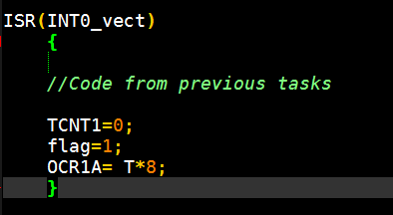
Extra task: control the phase of the strobe
To be able to control the phase (angle) of the stroboscope, you need simple modification to the code from task 5:
in the hardware interrupt you should wait not half a period, but some time which you calculate from the desired angle.

Slide 30
Microelectronic Control Systems
Temperature Control: Incubator

Slide 31
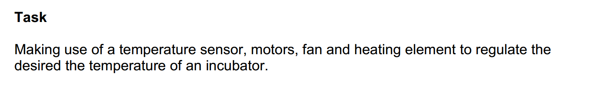
Incubator: the task
The task is rather generic.
To be more precise, to pass this lab you need:
Demonstrate reading sensor, controlling fan and both doors via servo motors
given a temperature value, you should be able to keep temperature within 2 C of this value for 5 minutes.
(remark: the code for this challenge is not properly tested. If you will have problem due to our code, but your control works, you pass)

Slide 32
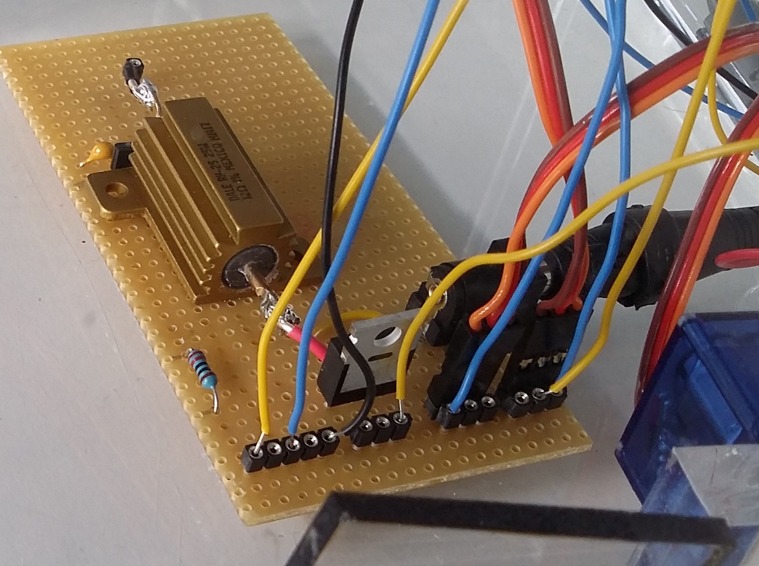
Incubator: the circuit
If Orange-Red-Brown wires are disconnected, ask staff to help you connect them right.
Two brown wires should be in the center near one another
Yellow – sensor power PC0
Blue – sensor signal PC1
Black - GND
Yellow – Heater control signal
Yellow – High
Blue1 – Control signal for door 1 (PB1)
Blue2 – Control signal for door 2 (PB2)

Slide 33
Incubator: reading sensor
The sensor used in TSIC digital temperature sensor. Therefore it does need the ADC to be read. Instead, a rather long sequence of signals allows us to get digital reading directly.
A function is already written in template:
Attention: use this function as
Get_TSIC_Temp(&value);
Not
Value=Get_TSIC_Temp(); //WRONG!!!

Slide 34
Controlling the fan and heater
The fan is connected by red and black wires. Black must be GND, red is an output pin (like PB4 or any other).
Use PWM to have it at custom power.
Heater connection is displayed on the circuit slide. It is powered using power supply, and we only control it using the power transistor. Again, you can use PWM to have it at fraction of full power.
Important: Heater is Active Low, meaning you need to output 0 for Heater ON, and 1 for Heater OFF.

Slide 35
Controlling the doors via servo motors
Servo motors receive their signal as PWM of particular frequency, and will take position depending on the duty cycle (% of the time on).
Use OCR1A and OCR1B registers to change position of doors. Make sure doors are not stuck trying to rotate below the floor of the incubator or nearby wall.
(Hint: initial value for the registers is 10000. Start by moving slightly from this value to discover the effect on servos.)

Slide 36
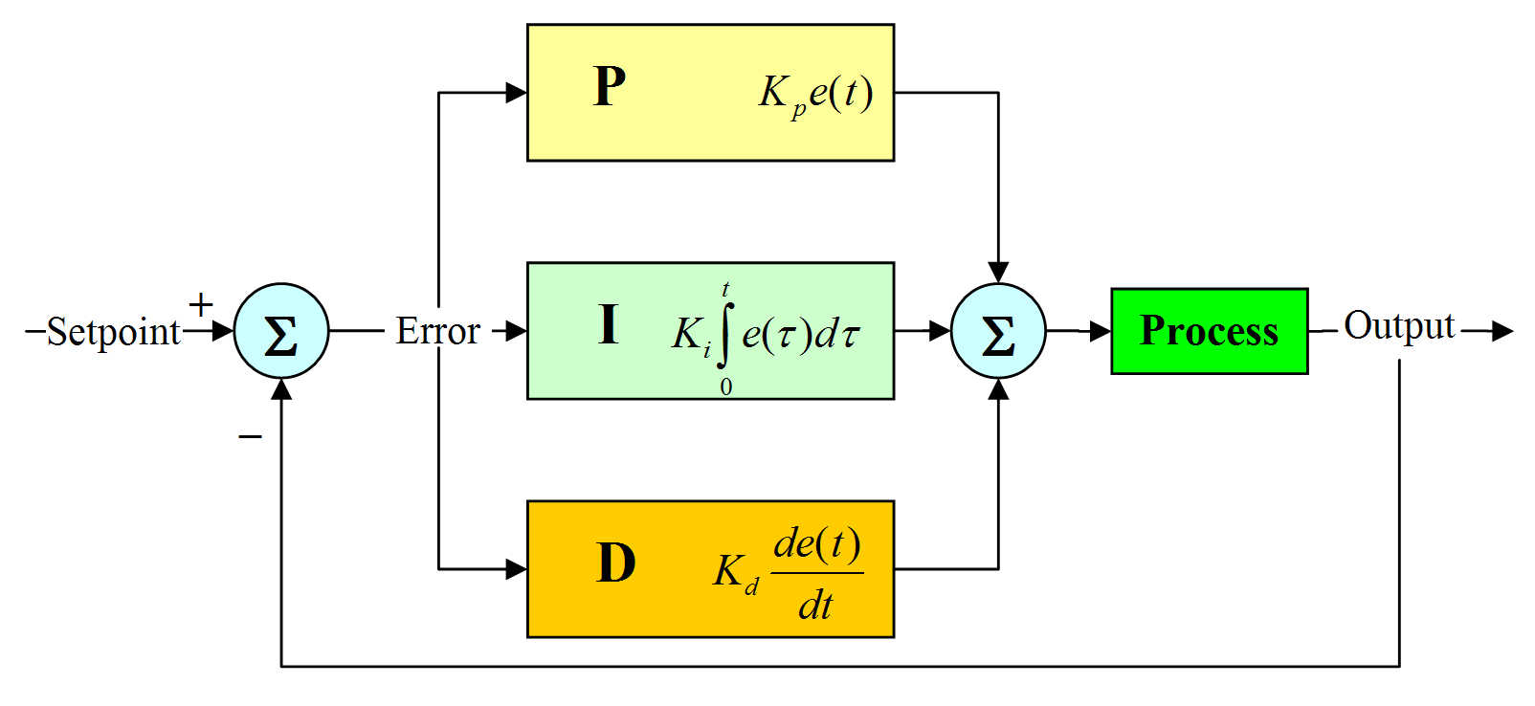
Construct a controller using AtMega8
Assume you have are given a setpoint, coefficients for PID controller and sensor reading as variables available to your C language program, as well as a variable responsible for the output. How code for a PID controller could look like?

Slide 37
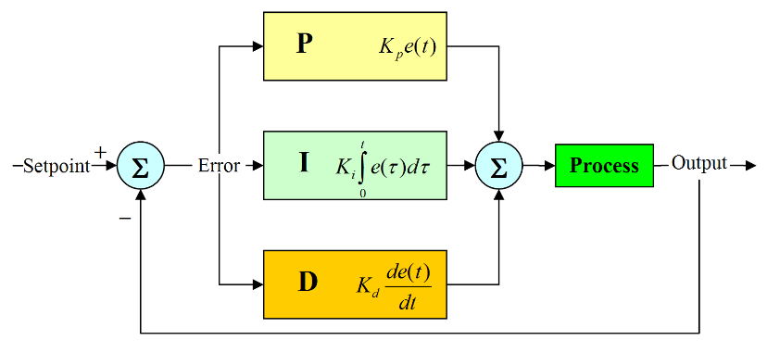
Controller using AtMega8
old_error=error;
error = setpoint – sensor;
intergral += error;
differential = (error – old_error) / time_step;
output = K*error + I*integral + D*differential;
to limit Integral part (preventing overflow and possible instability), add:
if(integral < INTEGRAL_MIN_VALUE)
integral = INTEGRAL_MIN_VALUE;
if(integral > INTEGRAL_MAX_VALUE)
integral = INTEGRAL_MAX_VALUE;

Slide 38
Better output calculation
additionally you might need:
a) to ensure the output does not overflow ( use code similar to the one for the integral)
if (output < OUTPUT_MIN_VALUE)
output = OUTPUT_MIN_VALUE;
if (output > OUTPUT_MAX_VALUE)
output = OUTPUT_MAX_VALUE;
b) use some initial value for output:
output = const + K*error + I*integral + D*differential;

Slide 39
What controller to use?
Your system can be characterized by rather high time constant; it is overactuated; doors influence the efficiency of the fan and vice versa.
What control would be optimal according to the control theory? Experiment with the system by trying at least 2 controllers.

Slide 40
Completing the incubator lab
given a temperature value, you should be able to keep temperature within 1 C of this value for 5 minutes.
To test your program, set
ready_challenge_flag=1;, assign some new value to setpoint.
Disable any LCD output from your program.
When your control is able to hold for 5 minutes, demonstrate it to a staff member.

